Slide 1
Software Quality Assurance and Testing
Lecture -11
Harish Aggarwal

Slide 2
Re-Cap
Lecture - 01
Definitions – S/W Quality, S/W Quality Assurance
Importance of QA
Causes of Defects
Business Models in S/W
S/W Cost, Quality Cost
Quality culture
Lecture - 02
Software Quality Models
McCall, IEEE 1061, ISO 25000 Series
Quality Requirements
Quality of Requirements
Frameworks
ISO/IEC/IEEE 12207 - Software Life Cycle Processes
Lecture - 03
Frameworks
CMMI-Development
ITIL Framework
Other Frameworks
Lecture - 04
ISO 25010 – Quality Attributes
Functional Suitability, Performance Efficiency, Compatibility, Usability, Reliability, Security, Maintainability, Portability
Lecture - 05
Software Testing Fundamentals
Software Verification and Validation
Types of Testing - Black Box, White Box Testing
Test Levels and Types –
Unit, Integration, System Testing

Slide 3
Re-Cap
Lecture - 06
Test Design Techniques
Combinatorial Testing
Boundary Value Analysis
Equivalence Class Partitioning
Lecture - 07
Test Methodology
Decision Table Testing
Test Execution Process
Test Case Design
Automated Testing
Alpha and Beta Site Testing
Regression Testing Strategies
Lecture - 08
Revision
Lecture - 09
Reviews - Informal Reviews, Formal Reviews
Personal, Peer, Walkthrough, Inspection, Audits
Types of Audits (Internal, Third Party)
Project Assessment and Control Process
Corrective Actions
Lecture - 10
Software configuration Management
Definitions, Benefits
SCM - IEEE 828, ISO 12207, CMMi-Dev
Baseline
Branching
Change Control

Slide 4
Agenda
Introduction to Test Process Improvement
Quality/Test Metrics

Slide 5
Test process Improvement - What
As name suggests - Improvement of the test process from various standpoints.
An iterative process.
Analyze the existing process, find issues, find corrective actions, implement.
Can be a continuous or non-continuous

Slide 6
Test process Improvement –
Why
Why to Conduct Test Process Improvement?
Testing improvements - When a test process is improved, naturally we see an improvement in the testing phases and the way things are executed.
Good quality software – More Exhaustive Testing. This will help expose more bugs which will ultimately improve the quality of the application.
Align testing with other phases – Helps align with changes in other phase like design, development, CI pipelines that get optimized with time.
Provide effectiveness in test activities – Helps streamlining the testing activities and improving each of them individually.
Improved costs - Improved processes are more effective in getting things done and hence require much fewer resources than before. E.g - Introduction to test automation.
Boosted business growth - Help deliver a high-quality application, with minimum costs and in the shortest possible time.

Slide 7
Test process Improvement –
Objectives
Objectives of Test Process Improvement
To enhance testing practices, efficiency, and overall software quality.
Adapt to changing requirements.
Deliver high-quality software.
Increases test coverage and test efficiency to identify more scenarios and to optimize resource utilization.
Deep understanding of the current testing processes, methodologies, and practices. Expands test automation coverage to efficiently execute repetitive test cases.
Highlights the areas in test cases that require changes. Enhance the test case design.
Traceability between requirements, test cases, and defects. Enhanced visibility in the testing process and easier impact analysis.
Mechanisms for continuous feedback, enabling timely identification and resolution of issues.
Embrace Agile and DevOps methodologies to align testing activities with development cycles, fostering collaboration and rapid delivery.

Slide 8
Test process Improvement –
When
When to Perform Test Process Improvement?
Significant rise in bugs - A rise in bugs indicates the weak areas of our application have increased and our testing methods are not proving to be effective.
Increase in complexity (test management) - People’s skills needs. Testing has become more complex and so is the need for Test resources.
Increase in involved resources – Increase in the size of test Team. Or when size of the Test team has not increased as per size of the project.
Increase in time of testing – When the timelines of testing phase is large. It will cause delay to project timelines.
Increase in testing costs – Includes cost of resources, timelines – delayed deliveries, tools, etc

Slide 9
Test process Improvement –
When
When to Perform Test Process Improvement?
Newer methods have arrived – When new technologies are available in the market that can help Testing. Initially cost can be high in purchasing, integrating, adapting, etc, but the return on investment in the long run can be high.
No retrospect for a long time - When test process improvement has not been done for a long time. It is always good to take a break and spend time in Analyzing the existing process at frequent intervals and make changes accordingly.

Slide 10
Test process Improvement –
How
How to Implement Test Process Improvement?
Diagnose the test improvement - First diagnose the situation. Focus on why test improvement is being done. Find the issues and report the findings. Give details (including historic data) on problem areas.
Initiate the process/planning phase - Plan the actions. Document objectives such as budget control, goals, risks in implementation, steps to be followed, and coverage of process improvement.
Acting on the plan - Actual implementation of test process improvement as per plan. Constant monitoring and tracking is required so as to adhere to schedule.
Verify, Report, and Learn – Verify results with planned expectations. Report results including metrics.
Lastly, retrospect on the test improvement process from phases 1 to 4 and document learnings throughout the process.

Slide 11
Test process Improvement –
Benefits
Benefits of Test Process Improvement
Identifies the weaknesses in the testing process, thus enhancing the effectiveness and efficiency of overall testing.
Enhance the test coverage and improve test case design, facilitating early detection of defects.
Promotes improved collaboration between development and testing teams
Shared understanding of quality goals, leading to smoother workflows and accelerated feedback loops.
Streamlines testing workflows and incorporates efficient practices.
Reduced testing cycles and contributing to faster delivery of high-quality software.
Higher test automation coverage and effectiveness of automated tests.
Meaningful metrics and reporting mechanisms to gain actionable insights.
Align testing practices with Agile and DevOps methodologies, ensuring that testing keeps pace with rapid development cycles and supports continuous integration and delivery.

Slide 12
Test process Improvement –
Measure
How to Measure Testing Process Improvement Impact?
Define Clear Objectives
Establish Baseline Metrics: Before implementing improvements, establish baseline metrics to understand the current state of the testing process.
Implement Changes Gradually: Helps in more controlled assessment of the impact of each change on the overall testing process.
Monitor Key Performance Indicators (KPIs): Identify key performance indicators that directly align with the objectives of the testing process improvement.
Compare Metrics Before and After Implementation
Calculate Return on Investment (ROI): Evaluate the return on investment by comparing the benefits gained from testing process improvements against the costs incurred in implementing those changes.
Surveys and Feedback: Administer surveys or conduct feedback sessions with the testing team to gauge their perceptions of the impact of process improvements.

Slide 13
Test process Improvement –
Model - TMMI
Similar to software development models (such as Agile and Waterfall).
Testing Maturity Model integration (TMMi) –
TMMi is a “maturity model” - Focuses on the maturity levels of testing lifecycle Processes.
Introduced in 2005.
The benefits of using TMMi models are:
Covers test-related activities extensively.
Covers the best practices from the existing models.
Covers the requirements for current trends and needs.
Covers all aspects of test quality as described by industry experts.
Provides a common standard for use.
Can be applied to all phases of the software development lifecycle.

Slide 14
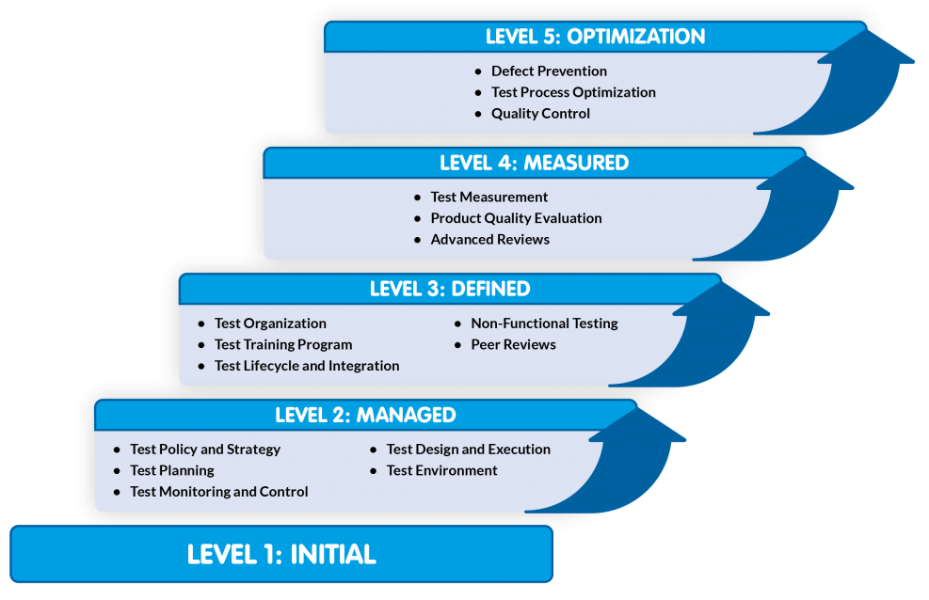
Test process Improvement –
Models - TMMI
Src : https://www.tmmi.org/tmmi-model/

Slide 15
Test process Improvement –
Model – TMMI - Levels
Testing Maturity Model integration (TMMi) – Levels
Maturity Level 1 – Initial –
Not defined by the TMMi model.
Basic level.
This includes debugging and chaotic (unorganized) processes.
Maturity Level 2 – Managed –
Basic test approach towards testing and manages the same approach.
Foundational structure in place that includes test planning, test policy, monitoring, and setting up of a test environment.
Maturity Level 3 – Defined –
Standardizes the testing process across the organization
Each project to follow the same process.
Testing is integrated very early into the development making it part of the development cycle.
Teams are required to be trained in testing and each member has a specific job for testing
Test teams are more organized.
Non-functional testing be planned and executed.

Slide 16
Test process Improvement –
Model – TMMI - Levels
Testing Maturity Model integration (TMMi) – Levels
Maturity Level 4 – Measured
Outcomes and parameter values are applied to all the projects to ensure a bug-free application
The review practices are more advanced and thorough in nature.
Maturity Level 5 – Optimization
Series of methods set up for optimization of the processes followed in testing
Continuous optimization leads to a bug-free application.

Slide 17
Test process Improvement –
Model – TPI-Next
Test Process Improvement (TPI) Next
The Test Process Improvement Next model, also called TPI Next, is the next generation of its predecessor TPI (Test Process Improvement) model.
The TPI Next model describes four maturity levels:
Maturity Level 1 – Initial
There is no fixed process.
The organization does not follow any rules and the process is chaotic.
Organization is already at the maturity level 1 with whatever approach they follow.
Maturity Level 2 – Controlled
Streamline the process with minimum structure.
The structure is organized and helps in reducing bugs.
Controlled state of the process and in no way is optimized.
Lot of bugs will still exist if the organization is at maturity level 2.

Slide 18
Test process Improvement –
Model – TPI-Next
Maturity Level 3 – Efficient
Efficiency of the currently working process in testing.
Not spending extra time on the redundant processes that arise when the testing process has certain overlapping stages.
Streamline processes and combine each process for a unified testing cycle.
Maturity Level 4 – Optimizing
Assign coordinators who evaluate the process continuously from time to time.
Optimize the process and improve it for the next project.
Includes evaluating the bugs faced, any delays, or any other type of hindrances faced during the run.

Slide 19
Test process Improvement –
Tools and Techniques
Essential Tools and Techniques for Test Process Improvement
Test Management Tools
Used for orchestrating and managing the entire testing process.
Facilitate test case design, execution, and reporting, streamlining collaboration among testing teams.
Popular examples include Jira,TestRail, etc.
Automation Testing Tools
For Automating repetitive test cases
Selenium - An open-source framework, supports web application automation with compatibility across multiple programming languages.
Testsigma - Cloud-based test automation platform that offers scriptless test automation
Continuous Integration/Continuous Delivery Tools (CI/CD)
Automate integration and deployment processes, ensuring a continuous and efficient development pipeline.
DevOps is a part of the automation testing process.
Enables automatic testing and delivery of the software, all the while logging the defects as well.
Tools such as Jenkins and GitLab

Slide 20
Test process Improvement –
Tools and Techniques
Essential Tools and Techniques for Test Process Improvement
RCA Techniques (Root cause Analysis)
Help identify and address the root causes of defects, preventing their recurrence.
RCA techniques like the 5 Whys and Fishbone Diagram (Ishikawa).
5 Whys involves asking “why” multiple times to delve deeper into the root cause
The Fishbone Diagram provides a visual representation categorizing potential causes, aiding in systematic analysis and problem-solving.
Risk-Based Testing
Risk-based testing focuses on areas with the highest risk of failure, efficiently allocating resources in those areas.
Techniques such as Failure Mode and Effect Analysis (FMEA) and Risk Matrix systematically evaluate and prioritize potential failure modes and risks.
FMEA identifies potential failure modes and their impact, allowing for proactive risk mitigation.
The Risk Matrix assesses and prioritizes risks based on likelihood and impact, guiding testing efforts toward critical areas.

Slide 21
Test process Improvement –
Best Practices
Best practices span the entire software development life cycle, from planning to execution, emphasizing collaboration, efficiency, and a commitment to ongoing learning.
Establish continuous feedback mechanisms throughout the SDLC.
Conduct thorough root cause analyses for defects. Utilize techniques like the 5 Whys or Fishbone Diagram to identify the underlying causes of issues.
Embrace iterative test planning that aligns with Agile and DevOps methodologies.
Aim for comprehensive test coverage by addressing various testing levels (unit, integration, system, etc.).
Aim for comprehensive test coverage both Functional and Non-Functional (Performance, Security, Reliability, etc).
Prioritize testing efforts based on risk assessment. Identify high-risk areas and allocate resources accordingly.
Implement automated regression testing to quickly validate existing functionalities after code changes.

Slide 22
Test process Improvement –
Best Practices
Best Practices
Embrace CI/CD practices to automate and streamline the integration and deployment processes.
Incorporate performance testing early in the development life cycle.
Establish robust test data management practices to ensure the availability of relevant and realistic test data.
Foster a culture of continuous learning within the testing team. Encourage the adoption of new tools, technologies, and best practices.
Encourage collaboration between development, testing, and other cross-functional teams.
Implement shift-left testing practices by involving testing activities early in the development process.

Slide 23
Test process Improvement –
Challenges
Challenges of Test Process Improvement
These are problems that can happen before and during improvement process of testing.
Limited resources, including time, budget, and skilled personnel.
Legacy systems may face challenges when integrating modern testing practices.
Employees lack the necessary training, leading to skill gaps that hinder effective implementation of improved practices.
Support from executive leadership
Integrating test process improvements seamlessly into existing development workflows can be challenging.
Organizations operating in regulated industries face challenges in aligning test processes with complex regulatory requirements.
Transitioning to Agile and DevOps methodologies poses challenges for organizations accustomed to traditional development approaches.
Applying improved processes across various projects and teams can be challenging.

Slide 24
S/W Quality Metrics –
Definition
Quality metrics is defined as a category of SQA tools:
A quantitative measure of the degree to which an item possesses a given quality attribute.
A function whose inputs are software data and whose output is a single numerical value that can be interpreted as the degree to which the software possesses a given quality attribute.

Slide 25
S/W Quality Metrics-
Objective
Main objectives of software quality metrics -
To facilitate management control as well as planning and execution of the appropriate managerial interventions. Based on -
Deviations of actual functional (quality) performance from planned performance
Deviations of actual timetable and budget performance from planned performance.
To identify situations that require or enable development or maintenance process improvement in the form of preventive or corrective actions introduced throughout the organization. Based on -
Accumulation of metrics information regarding the performance of teams, units, etc.

Slide 26
S/W Quality Metrics
Baseline and comparison
Quality metrics can be compared to -
Defined software quality standards
Quality targets set for organizations or individuals
Previous year’s quality achievements
Previous project’s quality achievements
Average quality levels achieved by other teams applying the same development tools in similar development environments
Average quality achievements of the organization
Industry practices for meeting quality requirements

Slide 27
S/W Quality Metrics
Classification
Quality metrics can be classified into -
Classification based on phase of life cycle of software system -
Process metrics, related to the software development process
Product metrics, related to software maintenance
Measured in terms of
KLOC – Thousand lines of code
Function Point – Functionality

Slide 28
S/W Quality Metrics
Process Metrics
Process metrics can be categorized as -
Software process quality metrics
Error density metrics
Number of Errors per lines of code or per Function Point
Errors can be weighted based on severity of error.
Error severity metrics.
Average severity of Errors
Software process timetable metrics
Average delay in completion of Milestones
Error removal effectiveness metrics
Errors Removal Effectiveness
Weighted Errors Removal Effectiveness
Software process productivity metrics
Development Productivity Hours/KLOC
Function point Development Productivity Hours/Function Point
Code Reuse - Reused lines of code
Documentation Reuse – Reused documentation

Slide 29
S/W Quality Metrics
Product Metrics
Product metrics - refer to the software system’s operational phase
Services provided can be
HelpDesk Services - For usage and application of S/W. Depends on S/W intuitiveness, friendliness.
HD calls density metrics – Number of calls in a timeframe.
Metrics of the severity of the HD issues raised – Average severity of HD Calls.
HD success metrics – the level of success in responding to these calls – Meeting SLA in resolution.
Corrective Maintenance Services – When failure occurs at customer site.
Software system failures density metrics – Failures per KLOC or FP
Software system failures severity metrics – Average severity of Failure
Failures of maintenance services metrics
Unable to complete the failure correction on time
Correction fails to fix failure - Maintenance Repeated repair Failure
Software system availability metrics
Full availability – All software system functions perform properly
Vital availability – No vital functions fail (but non-vital functions may fail)
Total unavailability – All software system functions fail.

Slide 30
S/W Quality Metrics
Implementation
Implementation requires
Definition of software quality metrics – relevant and adequate for teams, departments, etc.
Definition of attributes to be measured
Definition of the metrics that measure the required attributes
Comparative target values based on standards, previous year’s performance, etc.
Reporting method, including reporting process and frequency of reporting
Metrics data collection method.
Regular application by unit, etc.
Assigning responsibility for reporting and metrics data collection.
Instruction to the team regarding the new metrics.
Follow-up :
Updates and changes of metrics definitions.

Slide 31
S/W Quality Metrics
Implementation - 2
Implementation requires
Statistical analysis of collected metrics data
Descriptive statistics
Analytical statistics.
Subsequent actions:
Changes in the organization and methods (Process) used in S/W development
Change in metrics and metrics data collection
Application of data and data analysis to planning corrective actions for all the relevant units.

Slide 32
S/W Quality Metrics
Limitations
Application of quality metrics is strewn with obstacles. These can be grouped as follows:
Budget constraints in allocating the necessary resources (manpower, funds, etc.).
Human factors, especially opposition of employees to evaluation of their activities.
Uncertainty regarding the data’s validity, rooted in partial and biased reporting.
Parameters KLOC, Function point are subjective
Programming style
Volume of documentation comments included in the code
Software complexity
Percentage of reused code
Professionalism and thoroughness of design review and software testing teams.
Reporting style of the review and testing results

